Slide 1



Slide 2
Hash Table
Hash table is a data structure that supports searching, insertion and deletions (implementation of a hash table is called hashing )
The idea of hash table is an array of fixed size , containing no of elements
Search is performed based on keys
Each key is mapped to same position in the range (0 to tablesize-1)
The mapping is called hash function

Slide 4
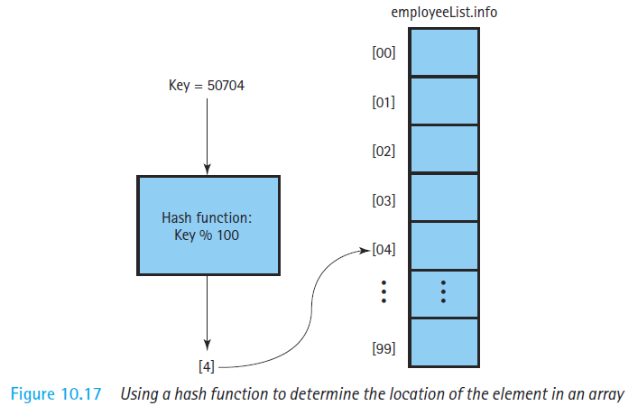

Slide 5
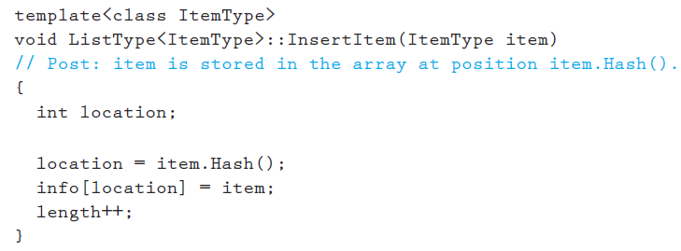

Slide 6



Slide 7
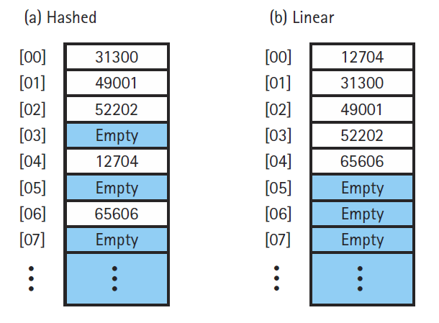

Slide 8
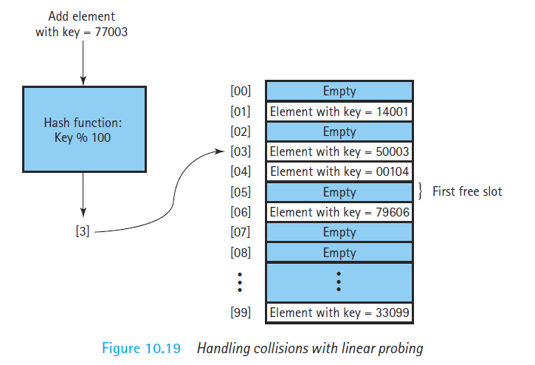

Slide 9
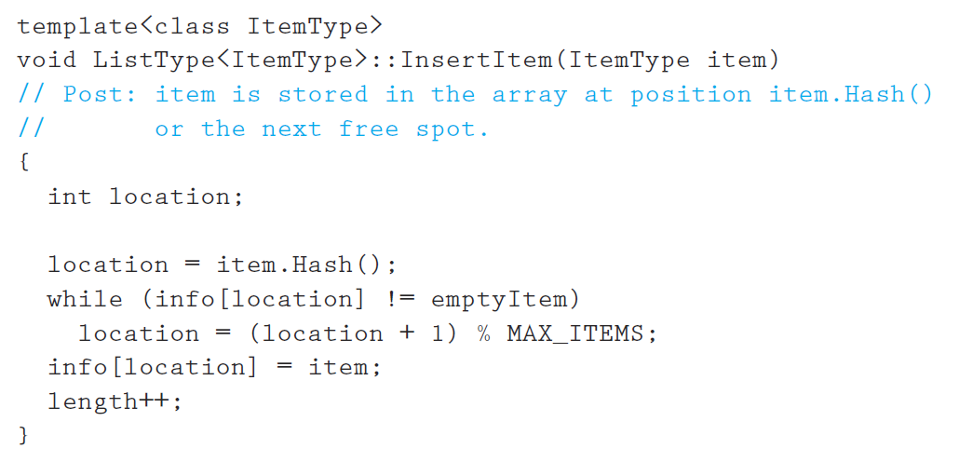

Slide 10
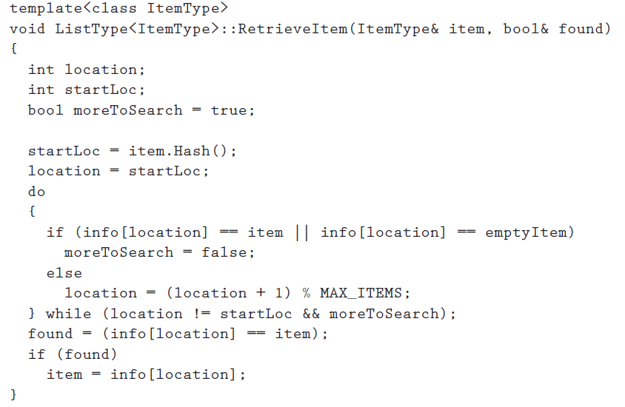

Slide 11
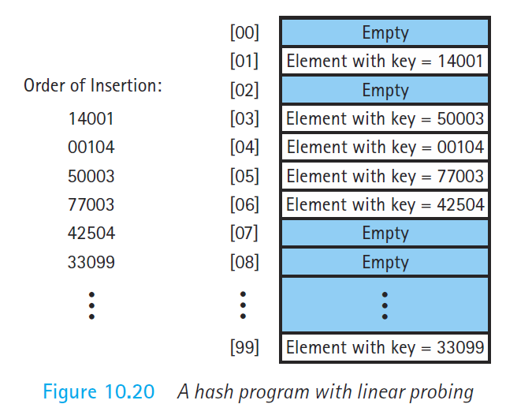

Slide 12





Slide 13
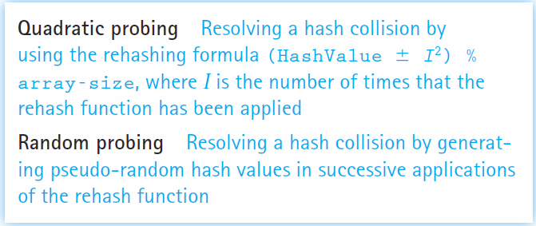

Slide 14


Slide 15
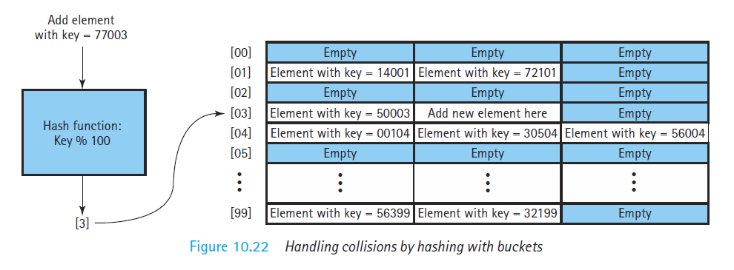

Slide 16
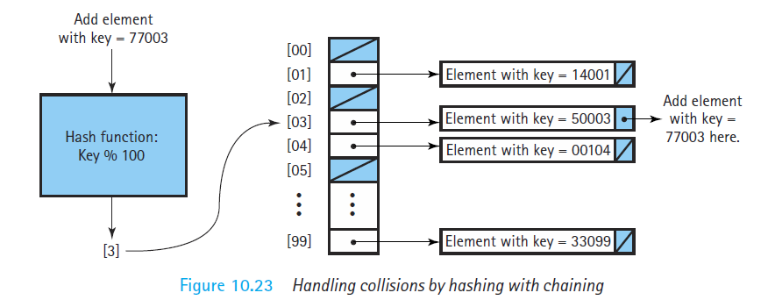

Slide 17
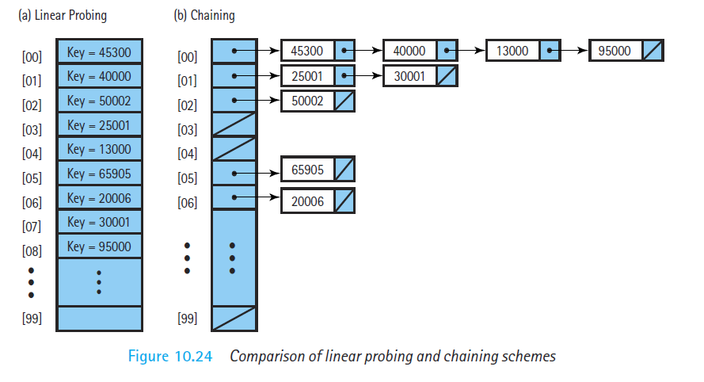

Slide 18



Choose a good hash function
Division method- key %table-size
Folding

